Slide 1
Introduction To Ethical Hacking
By Brandon S. Keath
Cyber Practice Lead

Slide 2

Who Is This Brandon Guy Anyway?
Lead Cyber Security Practice at Appalachia Technologies LLC
Master’s of Cyber Security and Information Assurance from Western Governor’s University
EC-Council Certified Ethical Hacker & Certified Hacking Forensics Investigator
I like to Program in Python and Hack stuff!
Notes:
My name is Brandon S. Keath I Lead the Cyber Security Practice at Appalachia Technologies, a cyber security company based near the capital of Pennsylvania, I have a master’s degree in Cyber Security from Western Governor’s University and after rigorous. If your in this field in general you tend to have a streak of curiosity.

Slide 3
Agenda
What is a Hacker?
What makes a hacker ethical
Mindset of a hacker?
Introduction To Ethical Hacking
Pre-Engagement
Intelligence Gathering
Threat Modeling/Vulnerability Analysis
Exploitation/Post-Exploitation
Reporting
Ethical Hacking What’s next?
Training Begins!
Websites For Learning Hacking
Capture The Flag!
Bug Bounty Hunting
Getting started in or enhancing your career in Cyber Security
Who Do Hackers Target?
Defense in Depth
Types of Cyber Security Professionals

Slide 4

What is a Hacker?
Modern Version of Hacker:
a person who uses computers to gain unauthorized access to data.
synonyms: cybercriminal, pirate, computer criminal, keylogger, keystroke logger;
Original Meaning:
Is any skilled computer expert that uses their technical knowledge to overcome a problem.

Slide 5

What is an Ethical Hacker?
A hacker who gains permission before attempting
To hack into a computer system, network, or device.

Slide 6


Mind Set of Hacker

Slide 7
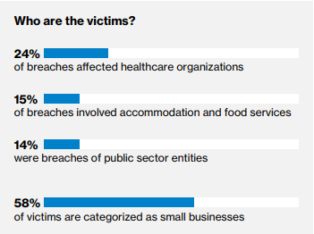
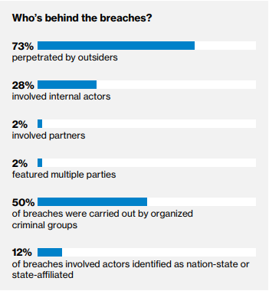
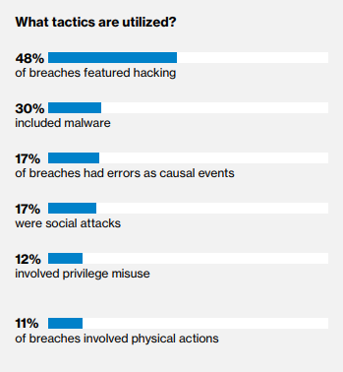
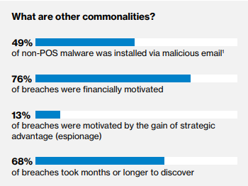
Who do Hackers Target???

Slide 8
Types of Cyber Security Professionals
Red
Team
Ethical Hacking
Network and Web Pen Testing
Blue
Team
Defense management
Antivirus, Encryption, Firewalls, SIEM, ETC
Purple
Team
Mix of red and blue team
Sometimes considered management or compliance related role.

Slide 9
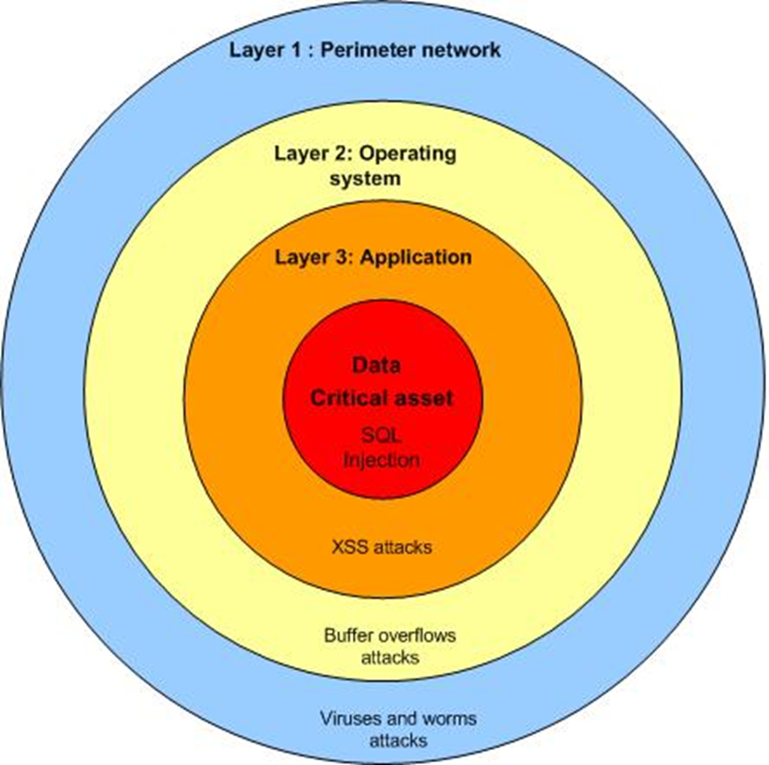
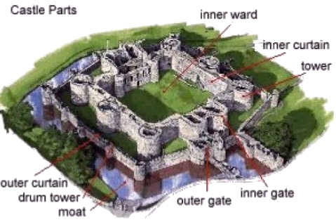
Defense In Depth

Slide 10
Hacking Methodology – Penetration Testing Execution Standard
Pre-engagement
Intelligence Gathering
Threat Modeling
Vulnerability Analysis
Exploitation
Post Exploitation
Reporting

Slide 11

Pre-Engagement
What is the scope of the engagement and objectives?
What are the rules for the engagement?
What is the reward for the engagement?

Slide 12


Intelligence Gathering/ Reconnaissance

Slide 13


Passive and Active Methods

Slide 14

Dumpster Diving

Slide 15
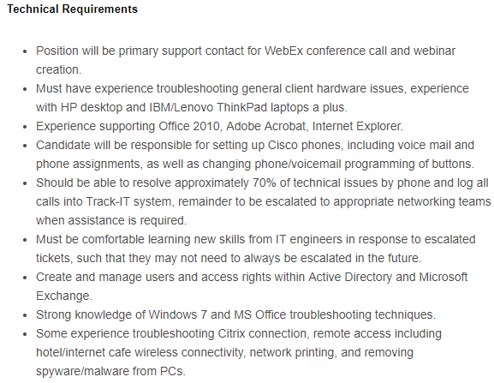
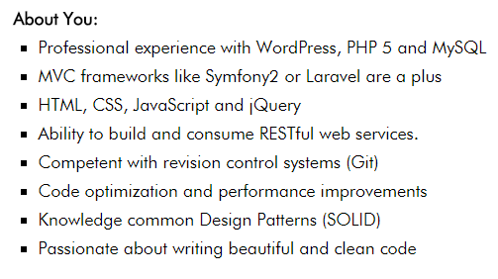
Look at Job Ad’s

Slide 16
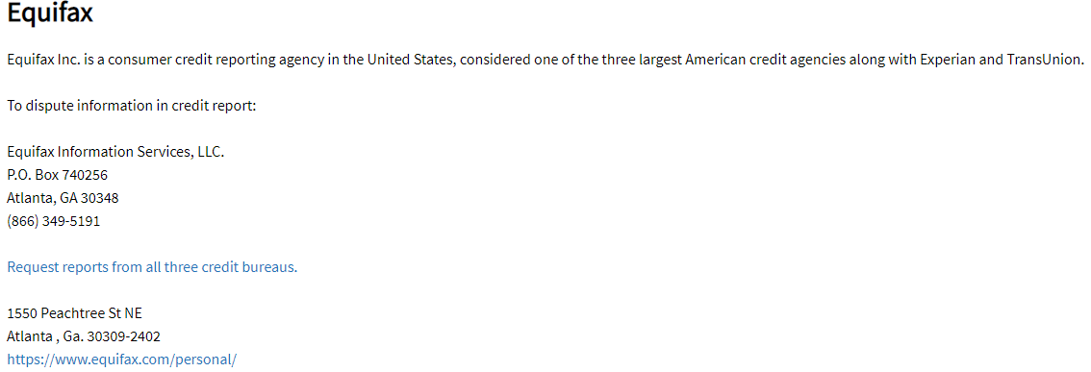
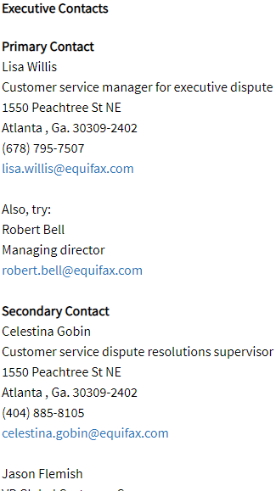
Look at Company contacts on Elliott Advocacy

Slide 17
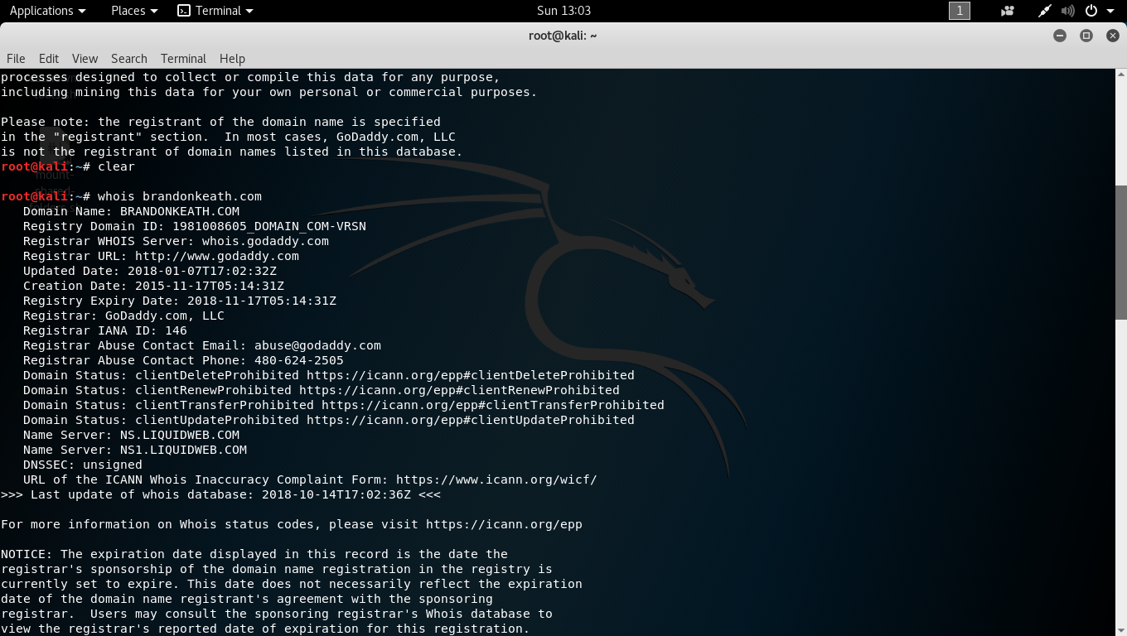
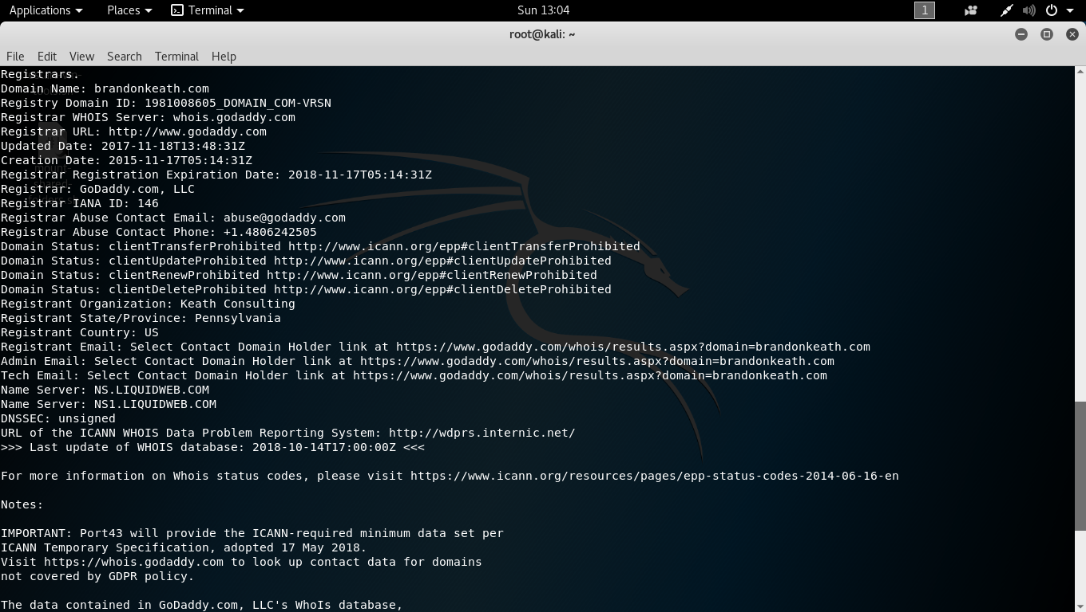
Whois Lookup

Slide 18
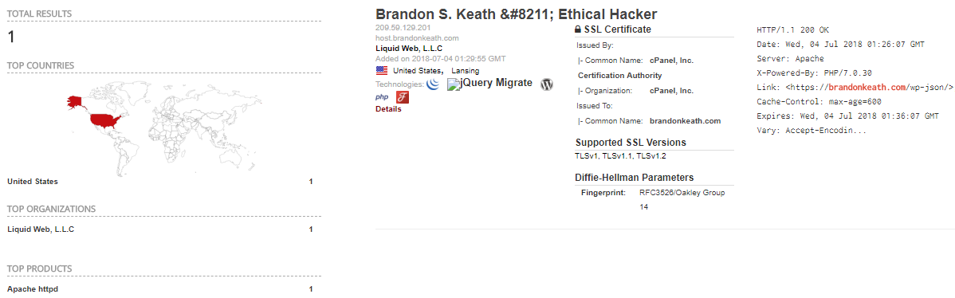
Shodan.io

Slide 19

WAY-WAY-BACK-MACHINE

Slide 20
Other Reconnaissance Tools
The Harvester – Command line tool for aggregating and gathering data from subdomains, hosts, SHODAN, etc.
Recon-ng – Full featured Web Reconnaissance framework written in python including various recon, discovery, reporting, and exploitation modules.
Malteo- Interactive data mining tool that ships with Kali Linux by default, ability to analyze relationships between information and graph information.

Slide 21
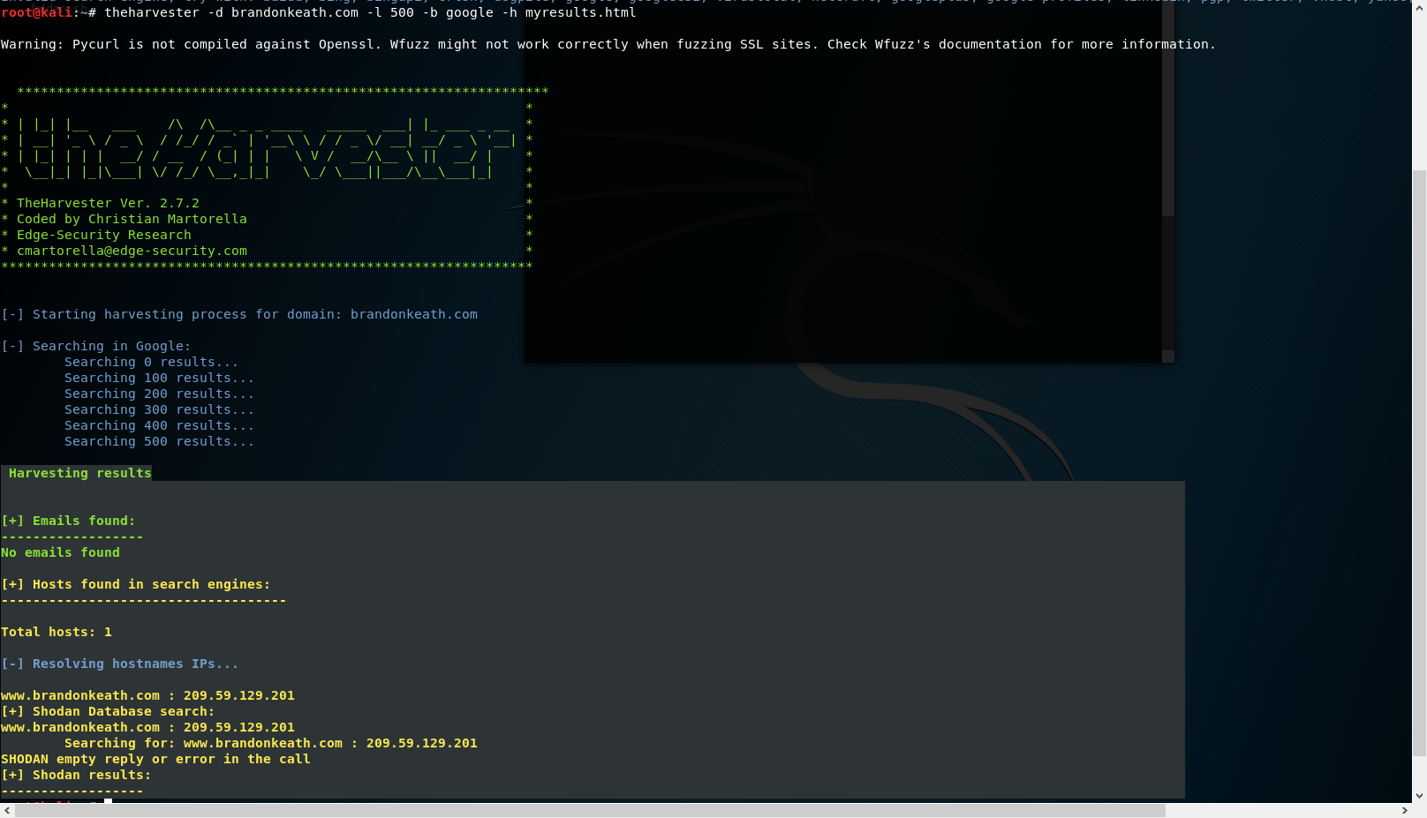

Slide 22
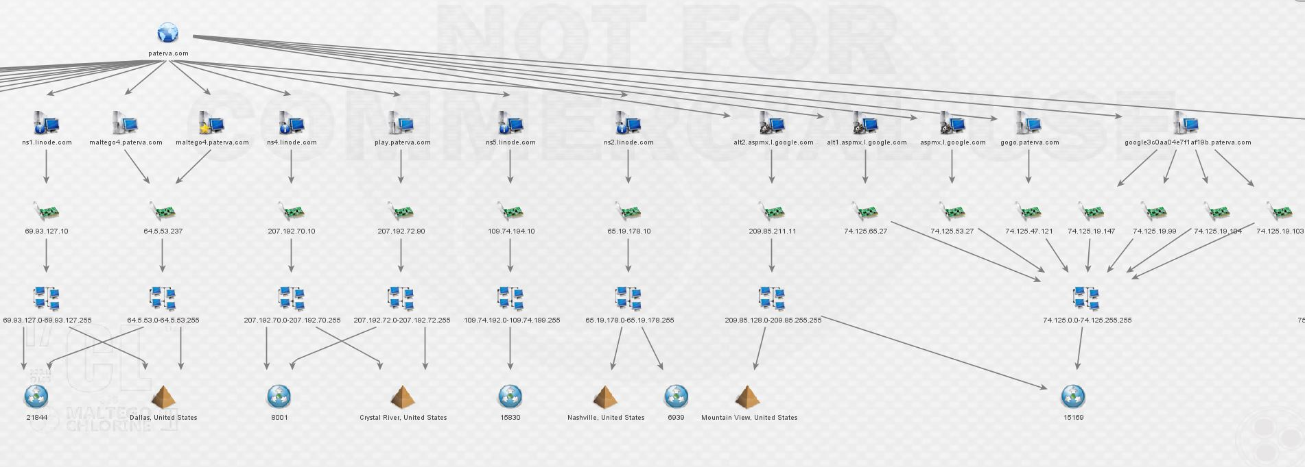
Maltego Example

Slide 23

Active Reconnaissance Scanning

Slide 24
Active Web Reconnaissance
Actively Visiting the Website
Scanning/Fingerprinting
Spidering
Intercepting Proxy

Slide 25
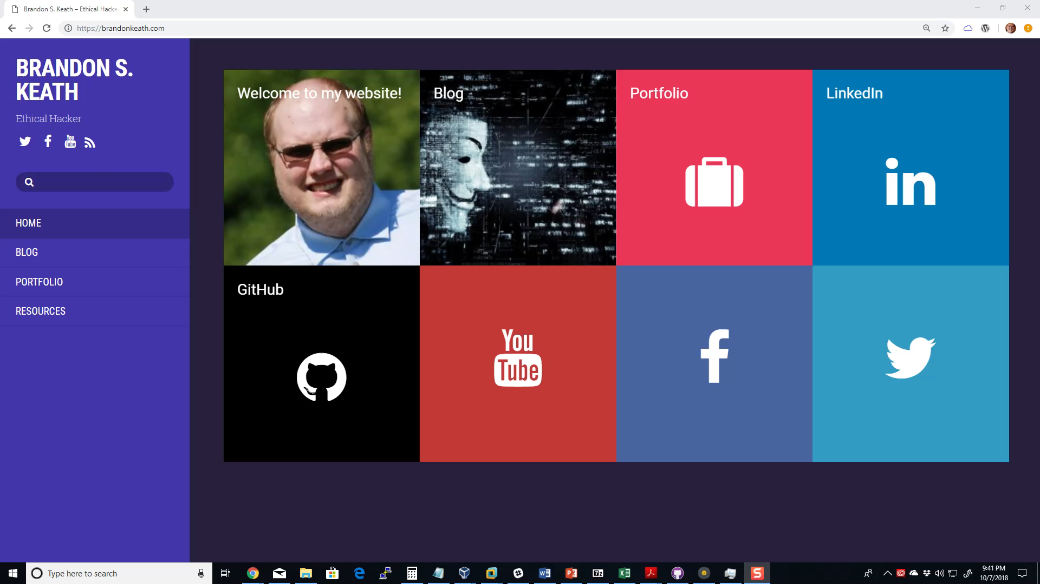
Wappalyzer

Slide 26
Nikto
Server Scanner
Looks for misconfigurations
Examines http headers
Can identify frameworks being used

Slide 27
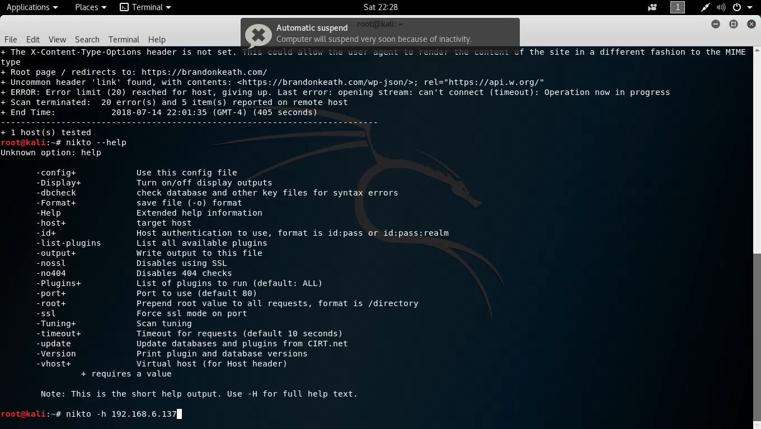
Scanning Demo Nikto

Slide 28
Skipfish
High speed web vulnerability scanner(400 requests per second)
Straight-forward and easy to use
Detects a wide range of issues including directory listings, disclosure vulnerabilities, and different types of SQL and XML injections

Slide 29
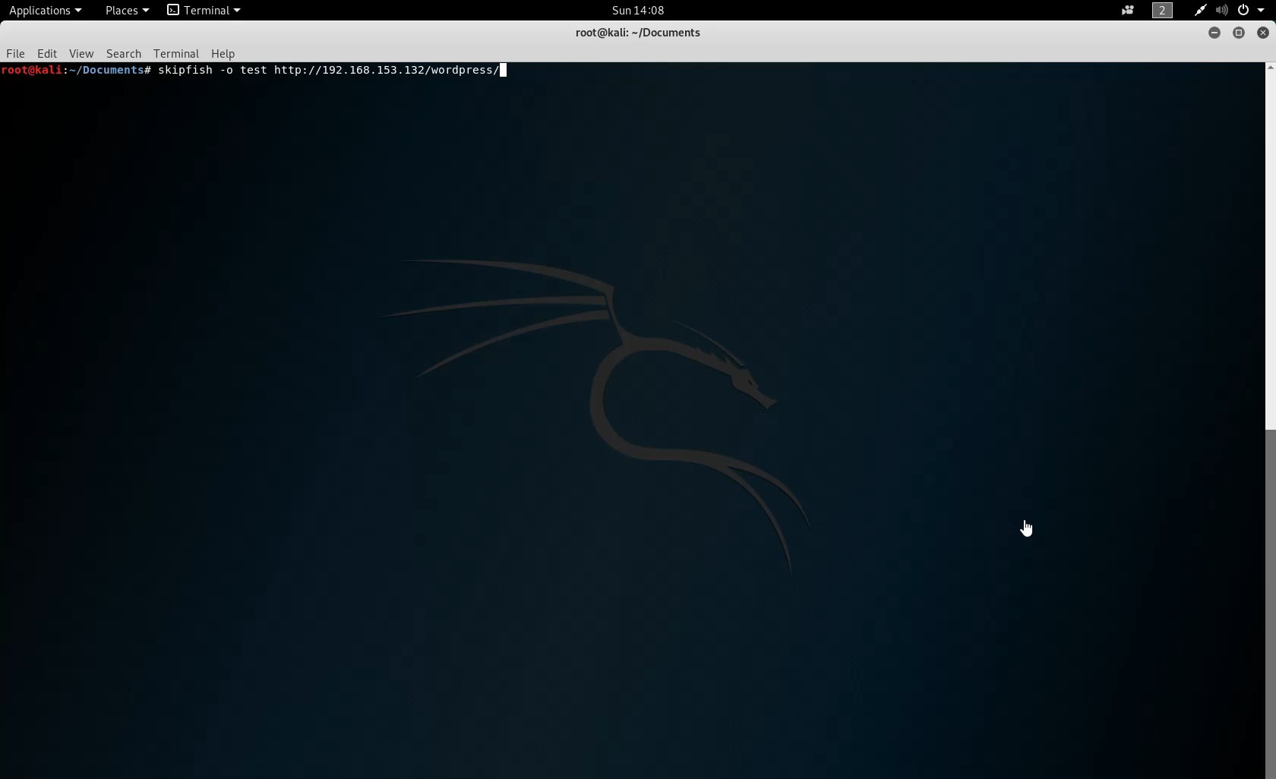

Slide 30
Arachni
Web Application Exploitation Framework
Automate and Schedule Scans
High success rate of detection
100% free and open source!

Slide 31
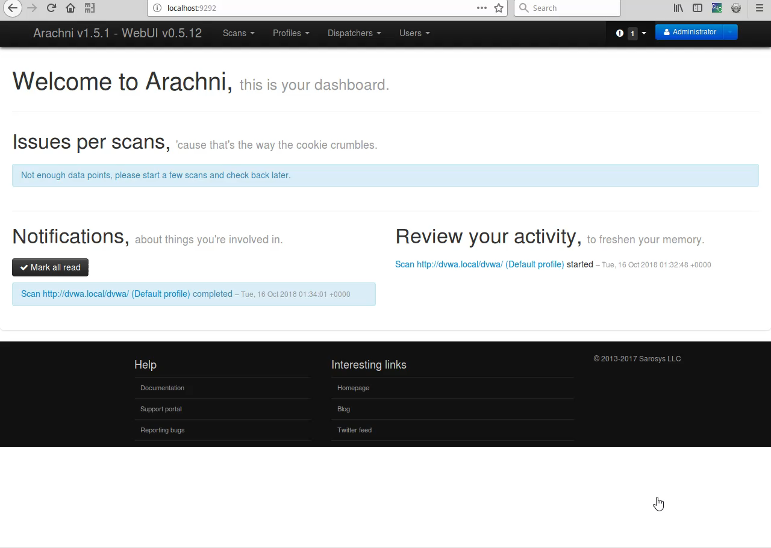
Arachni Demo

Slide 32
OWASP ZAP
OWASP ZAP is an easy to use integrated pen testing tool for finding vulnerabilities in web applications.
Zap provides automated tools and is an intercepting proxy that can be used for finding vulnerabilities.
Zap is a great tool for most web application penetration testing needs however Burp Suite Pro is considered more powerful

Slide 33
Burp Suite
Burp Suite is a commercial tool that includes the following:
Automated crawl and scan of 100 vulnerabilities
Intercept browser traffic as a man in the middle proxy
Automate custom attacks using Burp Intruder
Extensible with Python and Java Programming plugins
Burp is considered the standard for web penetration testing and costs $400 for a commercial license.

Slide 34





Network Vulnerability Scanners

Slide 35
Roll your own in Python & Automate!
Scapy – Python library that allows you to craft and forge your own packets, similar to NMAP.
Requests – A python library that allows you to send all kinds of http requests.
Scrapy- Python library that allows you to run, automate, and build your own web-spiders in Python just like ZAP & Burp!
MITMProxy- Command line proxy that can be used like Zap & Burp with a python API for automating repetitive tasks.

Slide 36

Review What is Reconnaissance

Slide 37
Threat Modeling
What did I find?
How valuable is what I found?
What is the threat to the business or Organization?
What threats does this organization face from cybercriminals?

Slide 38
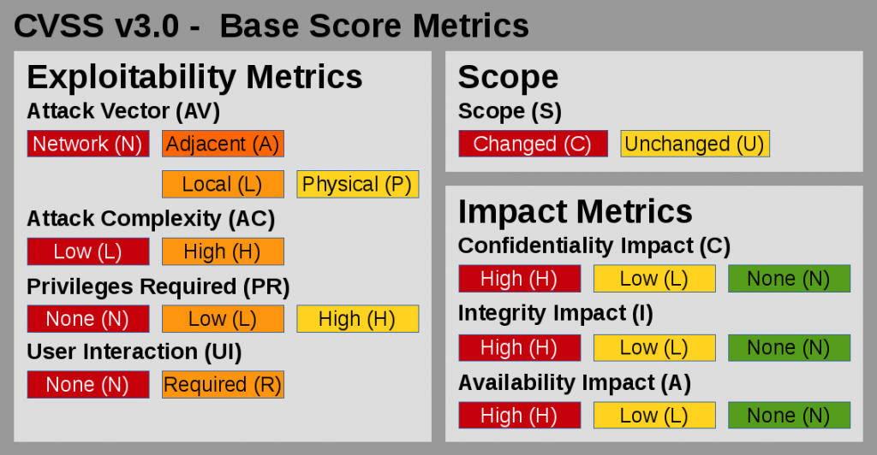
Vulnerability Analysis
OWASP Top 10
OWASP Testing Framework
Common Vulnerability Scoring System

Slide 39
Exploitation & Post Exploitation
Actively Exploiting the vulnerabilities(need permission first)
Verifying if vulnerabilities are accurate
Pivoting to other systems to test additional vulnerabilities
During Post-Exploitation, cleaning up any potential left over scripts.

Slide 40







Network Exploitation Tools

Slide 41
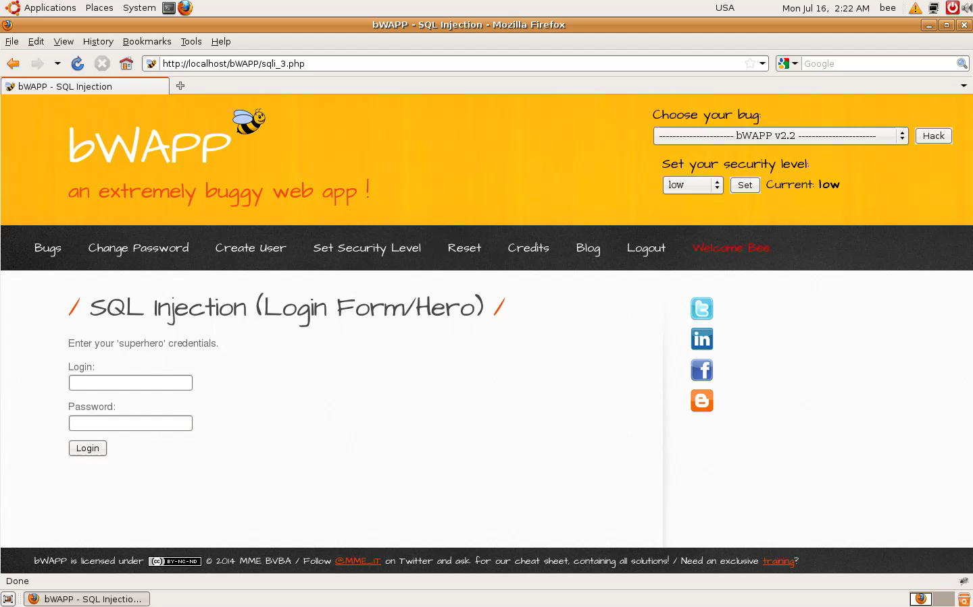
SQL Injection 2

Slide 42

Reporting
This Photo by Unknown Author is licensed under CC BY

Slide 43
Reporting Tips
Include concise clear information
Include an executive summary of findings
For bug bounties include a short video showing vulnerability
Give an explanation of the impact of the vulnerability to the organization!

Slide 44
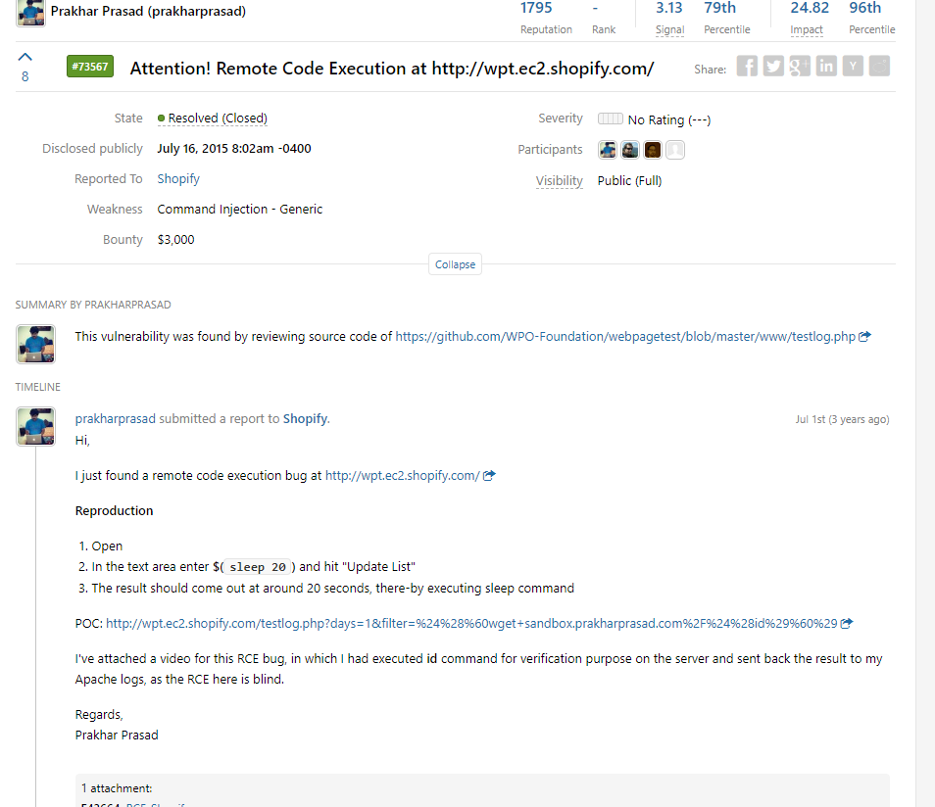
Example Reports
Reports can be shorter or longer depending on the engagement and the size of the engagement.
Penetration tests cost an average of $33,000 per engagement.
Bug Bounties focus on one particular flaw or error and payouts range from $50-$120,000 for one flaw.

Slide 45

This Photo by Unknown Author is licensed under CC BY-SA-NC

Slide 46
Let the Training Begin!
OWASP Broken Web Apps
Metasploitable2
Virtual Box for running various machines
Web Security Dojo
Download Kali Linux
HackSplaining is a great resource for learning about web exploits

Slide 47
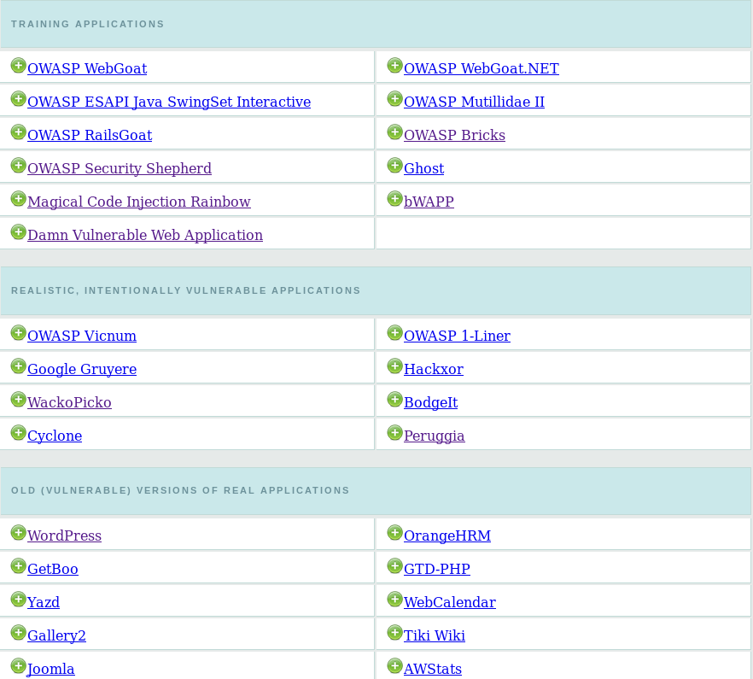
OWASP Broken Web Apps Training

Slide 48
Websites for Learning Hacking
https://www.offensive-security.com/metasploit-unleashed/
https://null-byte.wonderhowto.com/
HackTheBox
https://cybrary.it
Penetration Testing and Ethical Hacking by Ken Underhill

Slide 49
Bug Bounty Hunting?
Application Security Testing in Production!
Pro Bug bounty hunters earn between $10,000-$500,000/year as hunters - BugCrowd
www.hackerone.com
www.bugcrowd.com
https://www.hacker101.com/

Slide 50
Capture The Flag!
HackTheBox
CTF365
OverTheWire
Vulnhub
Pwnable.kr
HackThisSite
W3challs
HACK.ME
RingZer0 Team Online CTF
Try2Hack
HackThis!!
Enigma Group
RootMe

Slide 51

Resources for Getting Started in Cyber Security
Meetups and Events like this one!
https://Cybrary.IT
https://ElearnSecurity.com
Learn Python from Microsoft:
https://mva.microsoft.com/en-us/training-courses/introduction-to-programming-with-python-8360

Slide 52
In Sum
What is a hacker?
Ethical Hacking Lifecycle
How to get started in Ethical Hacking

Slide 53

Open Questions and Answers
Visit my terrible blog at www.brandonkeath.com for security updates.
Check out http://pahackers.com to stay up to date for new ethical hacking meet ups and events in the local Central PA area.
Link to slides:
https://github.com/PAHackers/Presentations
Sign up for the free Pen Testing Student
Class offered by ElearnSecurity by singing up for
The Ethical Hacker Network
https://www.ethicalhacker.net/register/

